Slide 1
Reading the SQL Server Execution Plan
Denny Cherry
mrdenny@mrdenny.com
MVP, MCSA, MCDBA, MCTS, MCITP

Slide 2
Agenda
What is an Execution Plan
Reading an Execution Plan
Execution Plan Operators
Changing the Execution Plan
Reading the Execution Plan
Demo

Slide 3
What is an Execution Plan
How the SQL Server access the data within the database.
Returned as XML or text when requested.
Displayed in a much more readable graphical form
Can not be edited directly
Can be adjusted with index hints
Can be set by pining Execution Plans
SQL chooses a Good Enough Plan not the perfect plan.

Slide 4
Reading an Execution Plan
Graphical Plan
  Read from Right To Left, Top to Bottom
  Follow Arrows until next branch from below
Text Plan
  Read from Left to Right, Top to Bottom
Each Operator has it’s own CPU and IO Statistics, both Estimates and Actuals

Slide 5
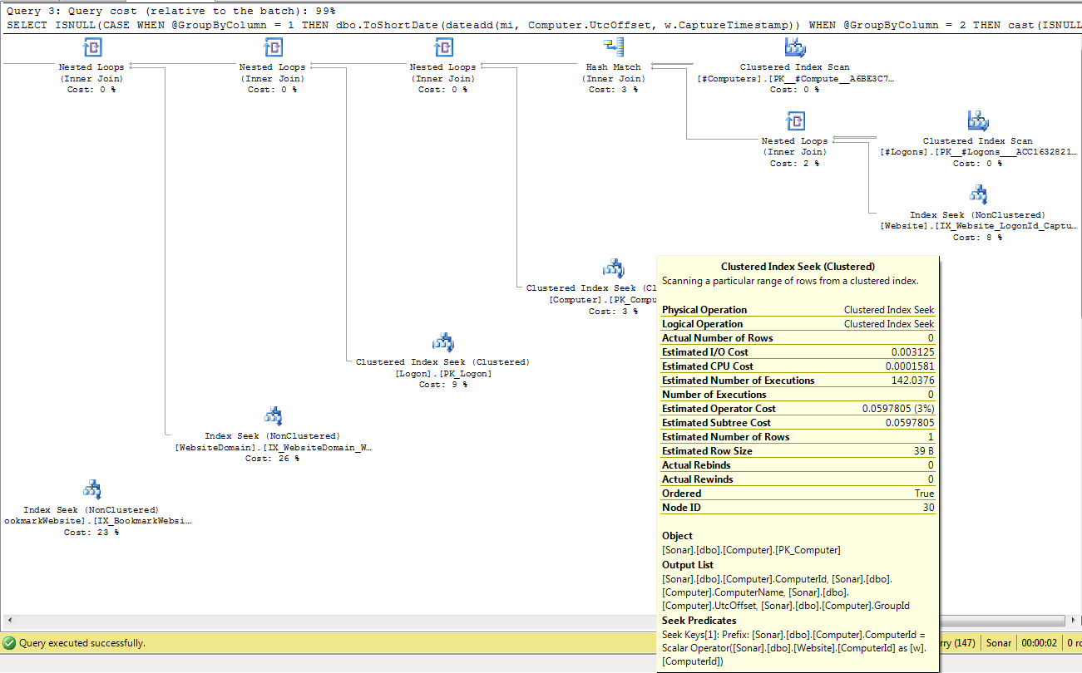
Reading an Execution Plan

Slide 6





Operators Finding Data
Index Seek – Reads the portion of the index which contains the needed data.
Index Scan – Reads the entire index for the needed data.
Table Scan – Reads the entire table for the needed data.
Key Lookup – Looks up values row by row for values which are missing from the index used.
Table Valued Function – Executes a table valued function within the database

Slide 7





Operators Filtering and Sorting
Nested Loops - Performs inner, outer, semi and anti semi join operations. Performs search on the inner table for each row of the outer table.
Hash Match - Creates a hash for required columns for each row. Then creates a hash for second table and finds matches.
TOP - Returns the specified top number of rows.
Sort - Sorts the incoming rows.
Stream Aggregate – groups rows by one or more columns and calculates one or more aggregate expressions.

Slide 8
Changing the Execution Plan
Index hints
  NOLOCK
  READPAST
  FIRSTFAST
  INDEX()
Pinning an Execution Plan
  sp_create_plan_guide
  sp_control_plan_guide
Adding Indexes To Tables
  Modify Indexes to remove scan and lookup operations

Slide 9
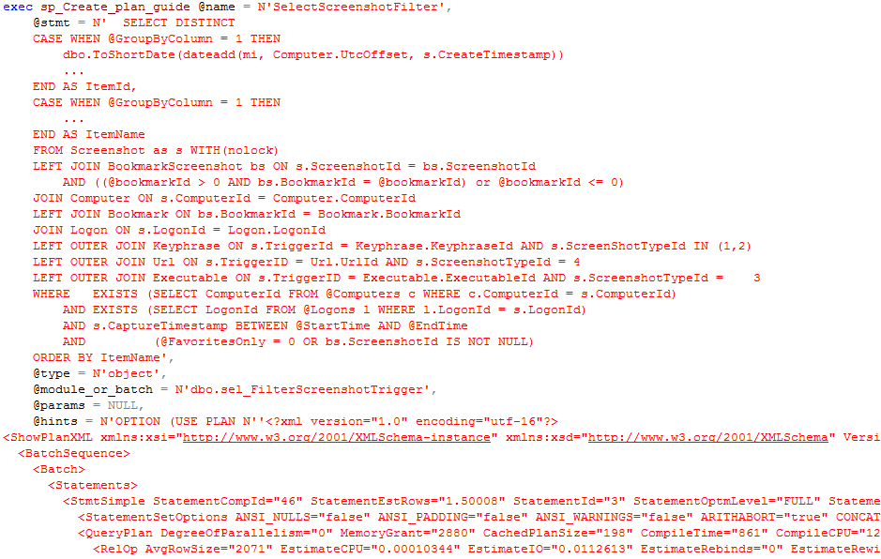
sp_create_plan_guide

Slide 10
sp_control_plan_guide

Slide 11




Denny Cherry
mrdenny@mrdenny.com
http://itke.techtarget.com/sql-server
Please fill out the survey at http://speakerrate.com/mrdenny.
Twitter
Contact Info
Blog

